Slide 1


Traffic Sign Classification with Transfer Learning
Studying the Impact of Data Augmentation and Synthetic Datasets
Prepared by Vishvesh Walunj & Mohneet Sandhu
95.83% Test Accuracy Achieved

Slide 2

Strategic Focus on 6-Class GTSRB Subset
Balancing Manageability with Robust Performance Evaluation
Primary Objective: Quantify impact of data strategies on recognition accuracy and robustness.
Metric
Detail
Dataset Choice: Focused study on a 6-class subset of the GTSRB dataset.
Target Classes
6 Distinct GTSRB Classes
Training Samples
7,776 images
Class Selection: Priority road, Yield, Stop, No entry, Road work, and Keep right.
Validation Samples
1,944 images
Test Samples
3,210 images
Statistical Significance: Clear comparative analysis across 12,930 total samples.

Slide 3

Rigorous Experimental Design Using ResNet50
Ensuring Fair Comparison Across Four Data Configurations
Framework utilizes an ImageNet-pretrained ResNet50 with a custom classification head. Backbone weights frozen to isolate the impact of data strategies.
Config 1: Baseline
Config 2: Augmented
Training on original data only. Fundamental benchmark for all experiments.
Original data + training-time augmentations (rotation, jittering) for real-time diversity.
Config 3: Synthesized
Config 4: Synth + Aug
Original data + pre-generated synthetic images with complex perturbations (blur, noise).
Hybrid approach: pre-generated synthetic samples + real-time augmentations.

Slide 4

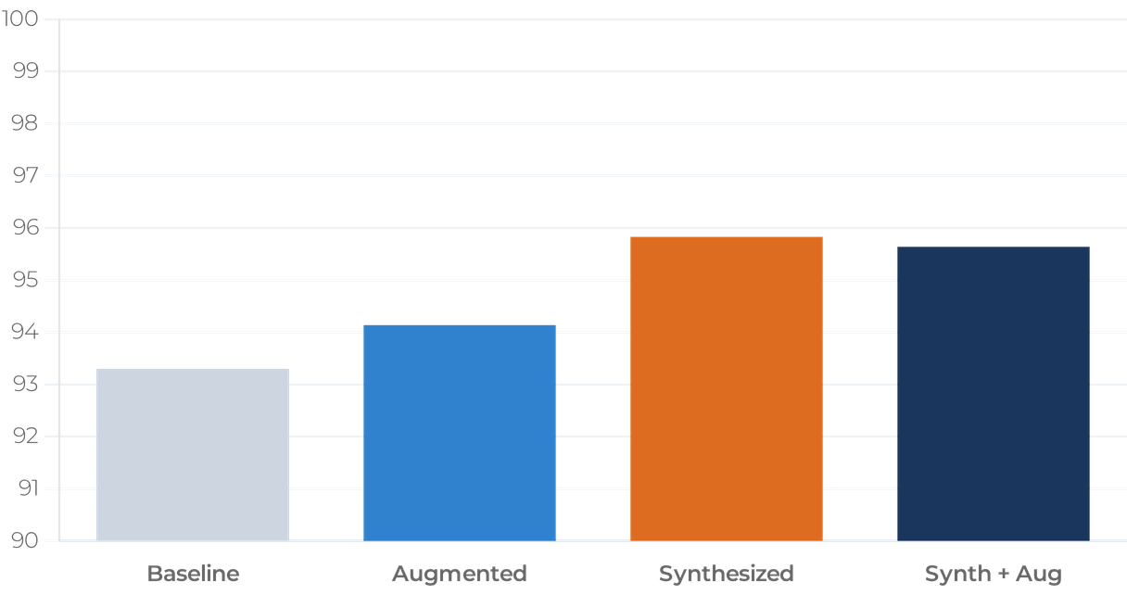
Synthesized Data Strategy Yields Superior Accuracy
Outperforming Standard Augmentation by Significant Margins
Configuration
Accuracy
Gain
Baseline
93.30%
-
Augmented
94.14%
+0.84%
Synthesized
95.83%
+2.53%
Synth + Aug
95.64%
+2.34%
The results demonstrate that the
Synthesized Data model
is the superior performer, achieving a peak test accuracy of
95.83%. This represents a substantial +2.53 percentage point gain over the baseline, suggesting that pre-generated synthetic
examples provide more effective diversity than standard real-time augmentation.

Slide 5

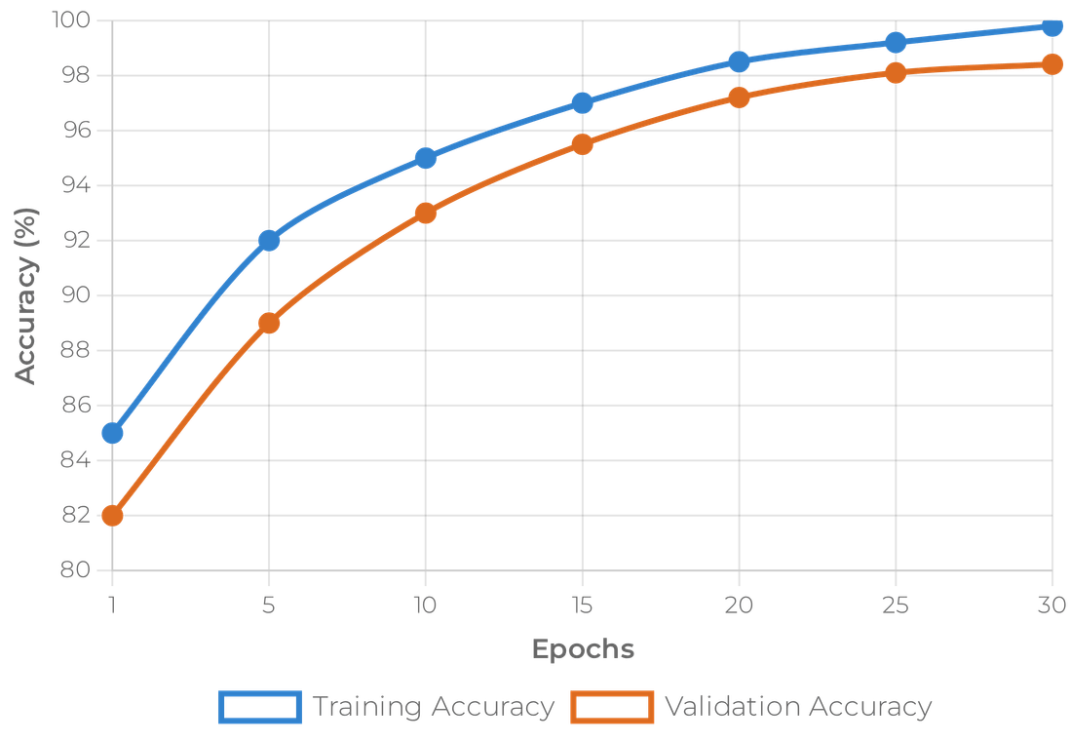
Stable Optimization and Strong Generalization
Validation Performance Reaches 98.41% with Synthesized Data
Optimization Stability: Steady decrease in training and validation loss across epochs.
Strong Generalization: Validation accuracy peaked at 98.41%.
Convergence Efficiency: Optimal performance reached reliably within epoch budget.
Reliability: No signs of divergence or overfitting during the training phase.

Slide 6

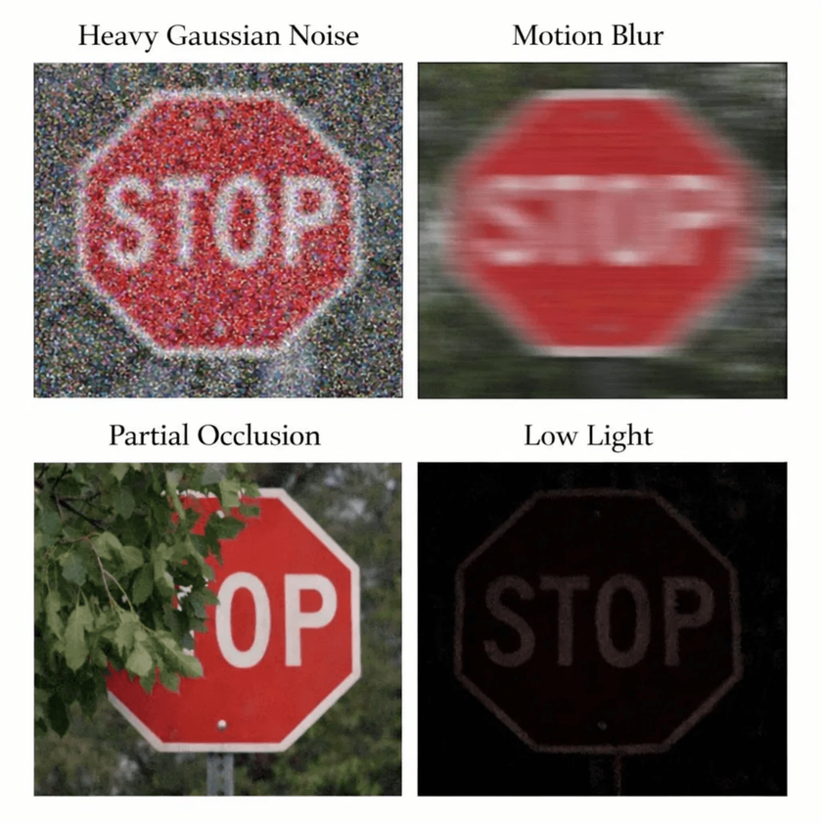
Visualizing Environmental Corruptions
Training Models to Recognize Signs Under Adverse Conditions
Gaussian Noise: Simulates sensor interference and low-quality imaging sensors.
Motion Blur: Represents camera movement or high-speed vehicle travel.
Partial Occlusion: Mimics blockage by foliage, debris, or other vehicles.
Low Light: Simulates evening, dawn, or tunnel driving conditions.
Synthetic perturbations effectively train the model to recognize structural symbols despite these visual degradations.

Slide 7

Synthetic Data Significantly Enhances Robustness
Outperforming Baseline Across All Environmental Corruptions
Stress Testing: Models evaluated under adverse conditions to simulate real-world autonomous driving challenges.
Corruption Type
Accuracy Gain (vs. Baseline)
+19.10 pts
Blur
Superior Performance: Synthesized-data model consistently outperformed baseline across every corruption type.
+18.85 pts
Gaussian Noise
Occlusion
+7.85 pts
Key Findings: Most significant gains observed under blur and noise, validating the impact of synthetic perturbations.
Low Light
+3.43 pts

Slide 8

Deep Dive into Model Strengths and Failure Modes
Structural Symbol Recognition Drives Success Under Stress
Success Factors
Identified Challenges
Geometric Signatures: "Road work" and "Keep right" remain highly accurate.
•
Structural Distortion: Severe noise and blur cause misclassification.
•
Precision Excellence: Stop signs achieved near-perfect precision across tests.
•
Recall Hurdles: Extreme conditions can cause missed Stop signs.
•
Contrast Stability: High-contrast symbols resist minor distortions.
•
Edge Degradation: Loss of boundary detail remains the primary hurdle.
•
"Synthetic training builds tolerance to degraded details, though extreme structural distortion remains a hurdle."

Slide 9

Conclusion and Strategic Roadmap
Validating Transfer Learning and Synthesis for Deployment
Key Takeaways
Future Development
Transfer Learning: ResNet50 is highly effective for specialized traffic sign tasks.
•
Scaling: Expand pipeline to the full 43-class GTSRB dataset.
•
Synthetic Advantage: Synthesis provides superior accuracy and robustness gains.
•
Optimization: Implement MobileNet backbones for edge deployment.
•
Strategic Priority: Synthetic data generation outperforms standard augmentation.
•
Fine-tuning: Explore unfreezing deeper layers for specific features.
•
Traffic Sign Classification Project © 2026
Resources available on
GitHub
https://github.com/walunjvishvesh21/CV_FINAL_PROJECT

